Slide 1



Bifurcations of periodic flows
around flapping bodies
Olivier MARQUET – ONERA (Meudon, France)
Collaborators
David FABRE (IMFT)
Angello IOLO & Michel BERGMANN (INRIA)
Damien JALLAS, Luis HENRIQUE BENETTI RAMOS (PhD ONERA)
The University of Melbourne, 10 March 2020
Notes:
Good afternon everyone,
My name is Luis, I am a PhD student from ONERA, the French Aerospace Lab.
I work in collaboration with my advisors Olivier Marquet from ONERA, and Angelo Iollo and Michel Bergmann from the University of Bordeaux.
My PhD subject deals with flapping propulsion:
Investigating the flow originated by a structure motion
And how this structure further interact with this fluid flow
Todays talk specifically deals with flow symmetry breaking that originates propulsion for vertically flapping foils.

Slide 2
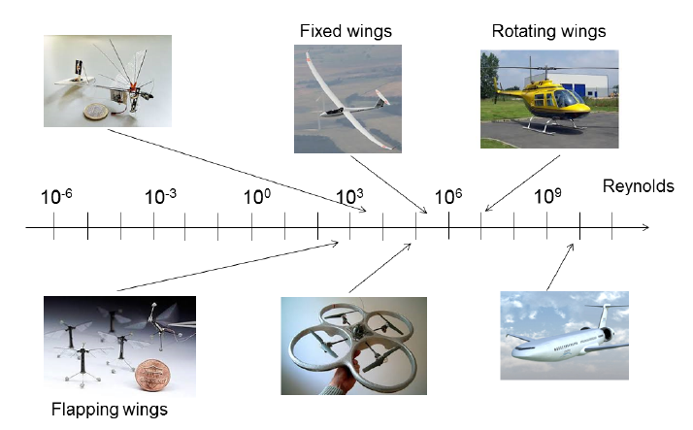
Motivations
Propulsion of flying machines
Notes:
Different modes for propulsion: rotating wings, fixed wings, flapping wings.

Slide 3
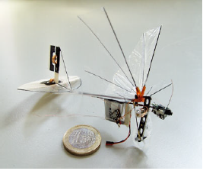
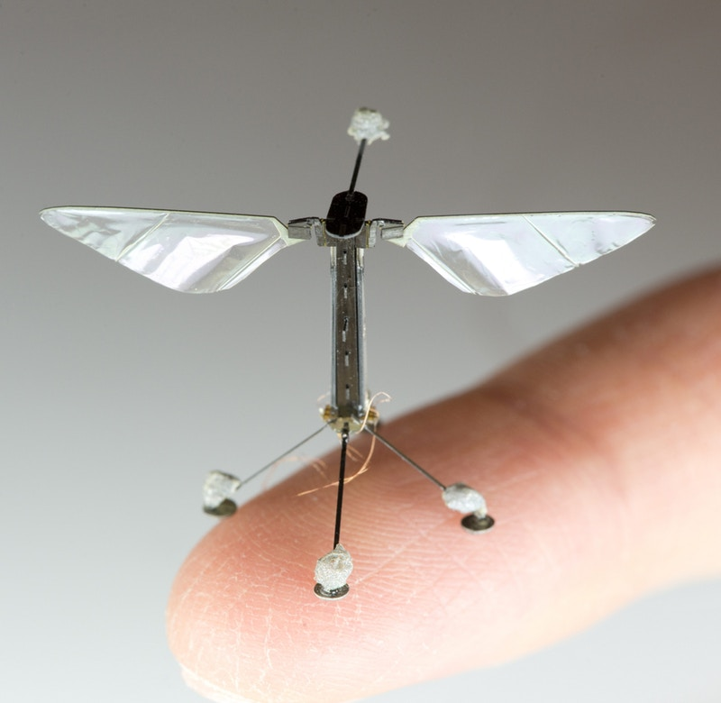
Motivations
Locomotion based on flapping wings
Delfly
Robobee
http://www.delfly.nl/
https://wyss.harvard.edu/
Maneouvrability / low sound signature
How small can we go?

Slide 4
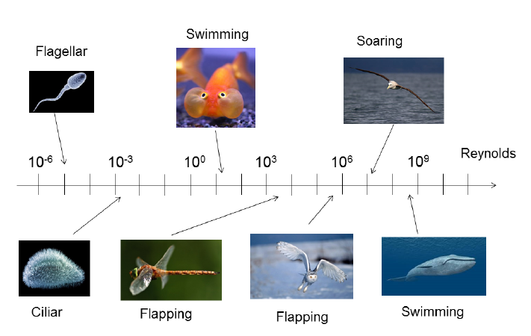
Motivations
Locomotion of living animals

Slide 5
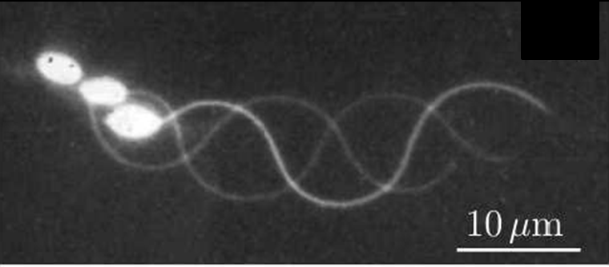
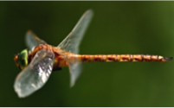
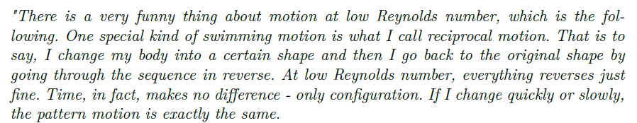


Motivations
Non-reciprocal motion
Reciprocal motion
$$Re<{10}^{−2}$$
$$Re>{10}^{1}$$
Purcell (1977)
« Life at low Reynolds number »

Slide 6
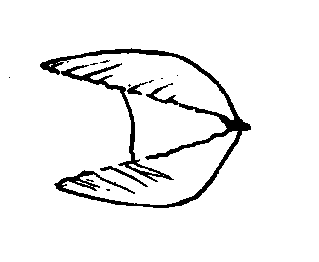
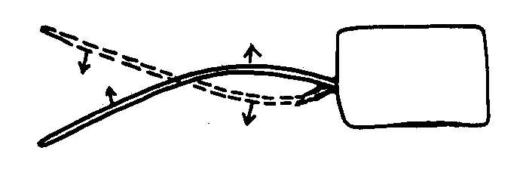
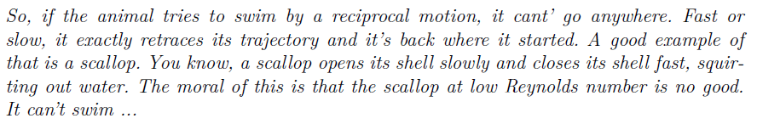
Motivations
Non-reciprocal motion
Reciprocal motion
Propulsion
Oscillation
Purcell (1977)
Scallop theorem

Slide 7
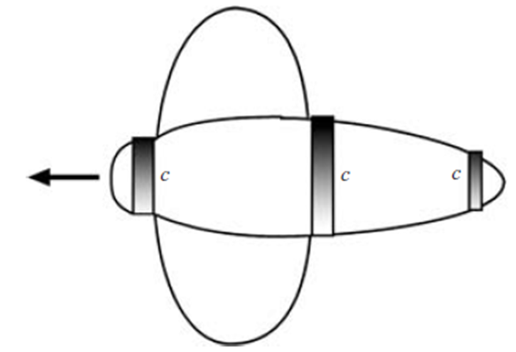

Motivations
Transition between non-reciprocal and reciprocal motions ?
Clione Antartica ($∼5 mm$)
Low speed
Ciliar locomotion
(gray bands)
High speed
Flapping locomotion
(wings)
Childress & Dudley (2004)
Is this transition related to a flow bifurcation ?

Slide 8
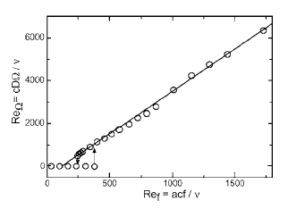
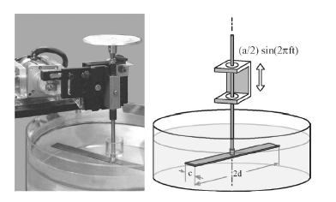
Self-propulsion of a symetric flapping wing
Symmetric-wing flapping vertically (quiescent fluid)
Experimental investigation
Vandenberghe et al. (2006)
Forced heaving
Free rotation
Self-rotation above a critical “Reynolds number” $Re_{f}=\frac{afc}{ν}$
Hysteresis effect

Slide 9
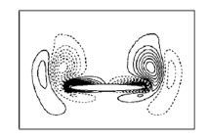
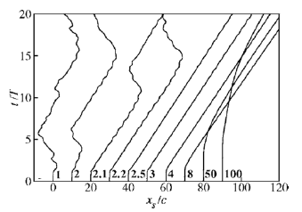
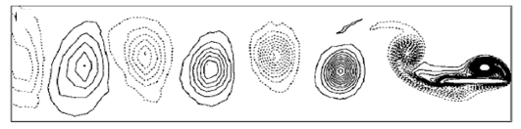

Self-propulsion of a symmetric flapping wing
Symmetric-wing flapping vertically (quiescent fluid)
Numerical simulations
Alben & Shelley (2005), Lu & Liao (2006), Zhang et al. (2010)
Forced heaving
Free horizontal motion
$$Re_{f}$$
Oscillating states found at low mass ratio

Slide 10
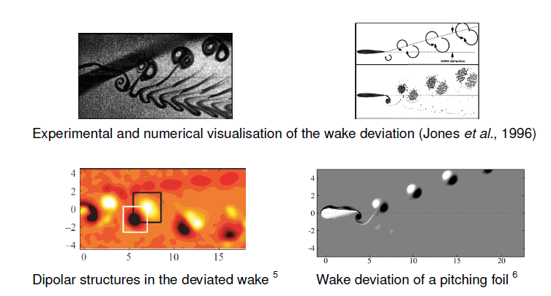
Deviation of the (self-)propelled wakes
Further increasing frequency : deviation of the wake
Godoy-Diana et al. (2008,2009)
Jallas et al. (2017)

Slide 11
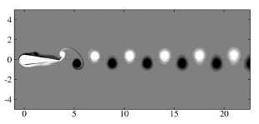
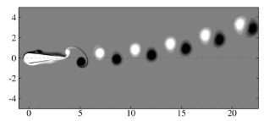
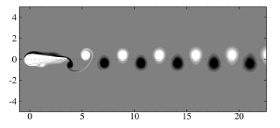
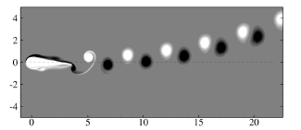




DEVIATION OF THE PROPULSIVE PERIODIC WAKE
Low frequency ($f=0.35)$
High frequency ($f=0.43)$
$$t=t_{0}$$
$$t=t_{0}+T/2$$
Instability of the periodic wake?

Slide 12
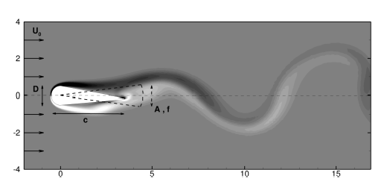
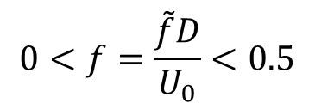
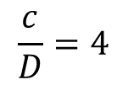
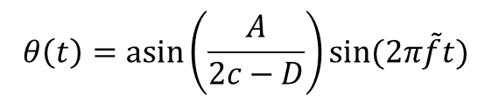
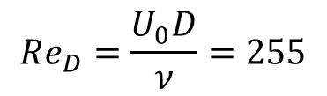
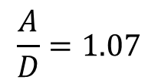
Configuration and non-dimensional parameters
$$θ\left(t\right)=\operatorname{asin}\left(\frac{A}{2c−D}\right)sin⁡(2π\tilde{f}t)$$
Godoy-Diana (2008)
$$\frac{A}{D}=1.07$$
$$Re_{D}=\frac{U_{0}D}{ν}=255$$
$$0<f=\frac{\tilde{f}D}{U_{0}}<0.5$$
$$\frac{c}{D}=4$$

Slide 13
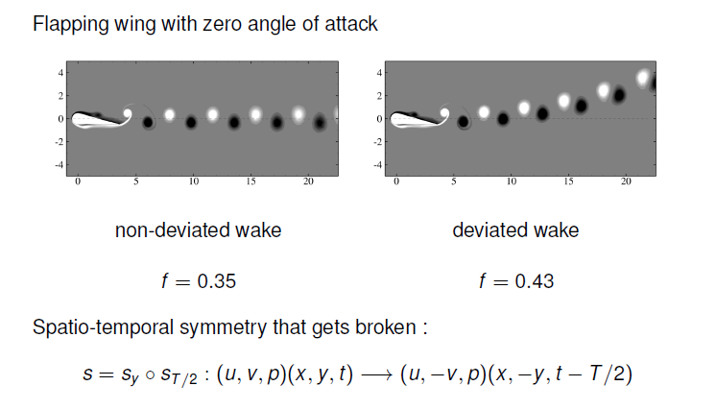
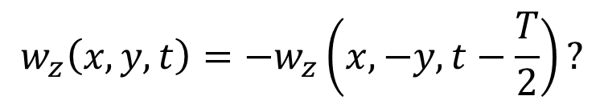
Spatio-temporal symmetry
Spatio-temporal symmetry
$$w_{z}\left(x,y,t\right)=−w_{z}\left(x,−y,t−\frac{T}{2}\right)?$$
YES
NO

Slide 14


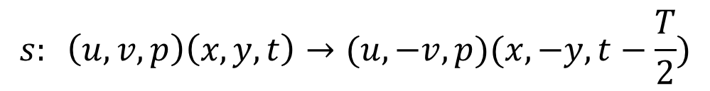

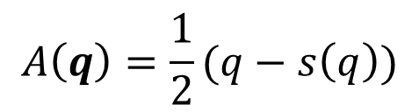
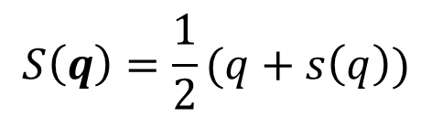


Spatio-temporal symmetry
$$s: \left(u,v,p\right)\left(x,y,t\right)→(u,−v,p)(x,−y,t−\frac{T}{2})$$
$$q(x,t)=(u,v,p)$$
$$S\left(q\right)=\frac{1}{2}(q+s\left(q\right))$$
$$A\left(q\right)=\frac{1}{2}(q−s\left(q\right))$$
Two projectors
$$q_{s}=S(q_{s})$$
$$q\left(x,t\right)=q_{s}\left(x,t\right)+q_{a}\left(x,t\right)$$
$$q_{a}=A(q_{a})$$
Objective
$$q\left(x,t\right)=Q_{s}\left(x,t\right)+0$$
Two methods to damp the anti-symmetric part

Slide 15
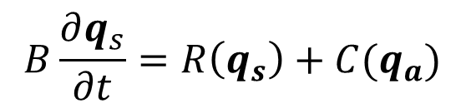
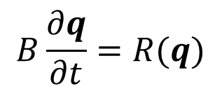

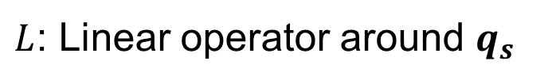
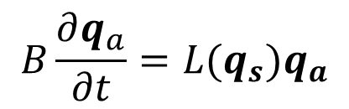
Decomposition-based method
Navier-Stokes equations
$$B\frac{∂q}{∂t}=R(q)$$
$$q=q_{s}+q_{a}$$
rewritten as two coupled equations
$$B\frac{∂q_{s}}{∂t}=R\left(q_{s}\right)+C(q_{a})$$
$$B\frac{∂q_{a}}{∂t}=L(q_{s})q_{a}$$
Symmetric
Anti-symmetric
$L$: Linear operator around $q_{s}$

Slide 16
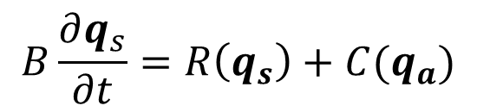
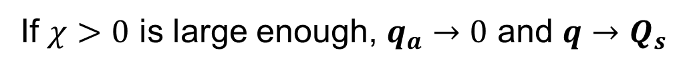
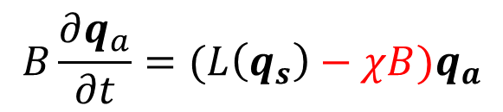
Decomposition-based method
Navier-Stokes equations
$$B\frac{∂q}{∂t}=R(q)$$
$$q=q_{s}+q_{a}$$
rewritten as two coupled equations
$$B\frac{∂q_{s}}{∂t}=R\left(q_{s}\right)+C(q_{a})$$
$$B\frac{∂q_{a}}{∂t}=(L\left(q_{s}\right)−χB)q_{a}$$
Symmetric
Anti-symmetric
Idea
Stabilize the anti-symmetric operator
If $χ>0$ is large enough, $q_{a}→0$ and $q→Q_{s}$

Slide 17
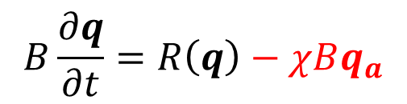
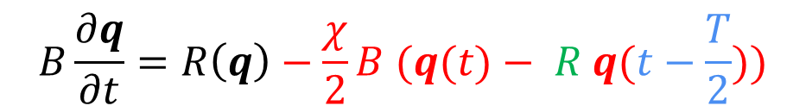
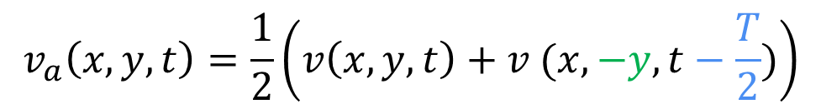
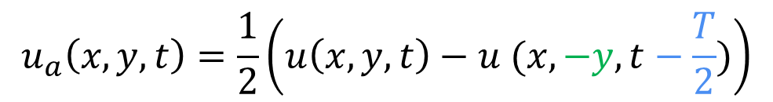
Extraction-based method
Navier-Stokes equations
$$B\frac{∂q}{∂t}=R\left(q\right)−χBq_{a}$$
How to extract the anti-symmetric component $q_{a}$?
$$u_{a}\left(x,y,t\right)=\frac{1}{2}\left(u\left(x,y,t\right)−u (x,−y,t−\frac{T}{2})\right)$$
$$v_{a}\left(x,y,t\right)=\frac{1}{2}\left(v\left(x,y,t\right)+v (x,−y,t−\frac{T}{2})\right)$$
$$B\frac{∂q}{∂t}=R\left(q\right)−\frac{χ}{2}B (q(t)− R q(t−\frac{T}{2}))$$
Reflectional symmetry
Time-delayed feedback

Slide 18
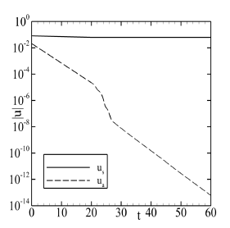
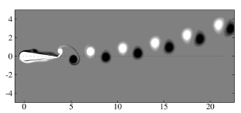
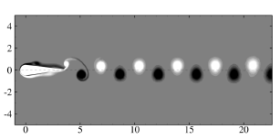
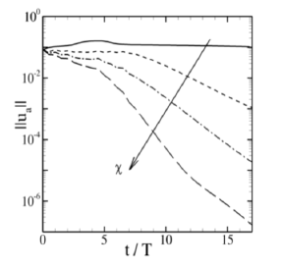





Results for the decomposition-based method
Evolution of $\left|\left|u_{a}\right|\right|$
$$χ=0$$
$$f=0.43$$
Effect of $χ$
$$χ=0.3$$

Slide 19
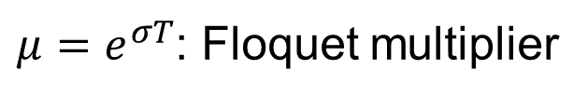


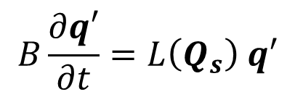

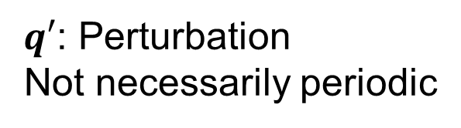

Floquet analysis of the stabilized periodic solution
$$q_{s}(x,t)=Q_{s}(x,t)+ε q′(x,t)$$
$Q_{s}$ : Stabilized solution
Periodic
$q′$: Perturbation
Not necessarily periodic
$$B\frac{∂q′}{∂t}=L\left(Q_{s}\right) q′$$
Floquet decomposition
$$q^{′}\left(x,t\right)=\hat{q}\left(x,t\right)e^{σt}$$
$$\hat{q}\left(x,t\right)=\hat{q}\left(x,t+T\right)$$
$μ=e^{σT}$: Floquet multiplier

Slide 20





Floquet analysis of the stabilized periodic solution
$$f=0.4$$
Evolution with $f$
Unstable synchronous
$$f_{c}∼0.38$$

Slide 21



Floquet analysis of the stabilized periodic solution
$$f=0.4$$
Periodic symmetric solution
Array of
counter-rotating monopole vortices
Array of
counter-rotating dipole vortices
Unstable Floquet mode

Slide 22

Floquet analysis of the stabilized periodic solution
$$f=0.4$$
Periodic symmetric solution
Superposition
Array of displacement modes
Unstable Floquet mode

Slide 23




Non-linear effect
Mean propulsive force
The deviation increases
the propulsion

Slide 24

3D effects
Godoy-Diana et al. (2008)

Slide 25
SELF-PROPULSION OF A
SYMMETRIC FLAPPING PLATE
Lu & Liao (2006)

Slide 26





Configuration and non-dimensional parameters
$$h/c=0.05$$
$$ν,ρ_{f}$$
$$y_{g}(\tilde{t})=A\sin{(2πf\tilde{t})}$$
Forced oscillation along y:
Free to move along x in an initially quiescent fluid
Non-dimensional parameters
$A/c=0.5 β=fc^{2}/ν$ $ρ=\frac{ρ_{s}}{ρ_{f}}$

Slide 27



Non-dimensional governing equations
Incompressible Navier-Stokes equations
in a translating frame of reference
$$\frac{∂u}{∂t}+\left(\left[u−u_{g}e_{x}\right]⋅∇\right)u=−∇p+\frac{1}{β} Δu$$
$$∇⋅u=0$$
$$u\left(Γ_{w}\right)=u_{g} v\left(Γ_{w}\right) = 2 π (A/c) \cos\left(2π t\right))$$
$$ρ S\frac{du_{g}}{dt}=\int_{Γ_{w}}{\left(σ(u,p)⋅n\right)⋅e_{x}}$$

Slide 28



Three regimes of solutions for $β<20$
Low flapping frequency ($β<4.5)$
The flow has the y-reflectional symmetry
No instantaneous horizontal force ($F_{x}(t)=0)$
No propulsion $(u_{g}(t)=0)$

Slide 29



Propulsive regime
Intermediate flapping frequency ($4.5<β<9$)
Slight asymmetry of the flow - Propulsion $(<u_{g}\left(t\right)>_{T}≠0)$

Slide 30




Back and forth regime
Large flapping frequency ($11<β<20$)

Slide 31

Summary of non-linear results
Propulsive regime
Back & Forth regime
Mean velocity
Frequencies
Can we predict the regime of solution with linear analysis ?

Slide 32







Linear analysis of the periodic and symmetric solution
Symmetric periodic solutions
Propulsive regime ($β=6)$
Back and forth regime ($β=13)$
Synchronous mode ($μ$ real)
Asynchronous mode ($μ$ complex)

Slide 33


Linear analysis of the periodic and symmetric solution
Propulsive regime ($β=6)$
The solid perturbation velocity oscillates around a non-zero value
Linear propulsive effect

Slide 34







Linear analysis of the periodic and symmetric solution
Back and forth regime ($β=13)$
$μ=\left|μ\right|e^{i φ}$
$$\left|μ\right|=e^{σT}$$
$$=e^{σ_{r}T}e^{{iσ}_{i}T}$$
$φ=σ_{i}T$
$\tilde{f}=\frac{φ}{2π}=\frac{σ_{i}}{2π}f$
Perturbation frequency
Flapping frequency
Low
$$\tilde{f}=0.032 f$$
High

Slide 35




Linear analysis of the periodic and symmetric solution
Back and forth regime ($β=13)$
$${\hat{q}}_{r}(t)$$
$$q^{′}\left(t\right)=ℜ\left( \left({\hat{q}}_{r}\left(t\right)+i {\hat{q}}_{i}\left(t\right)\right)e^{\left(σ_{r}+i σ_{i}\right)t} \right)$$
$${\hat{q}}_{i}(t)$$

Slide 36

Linear analysis of the periodic and symmetric solution
Back and forth regime ($β=13)$
Temporel evolution over one long period (low frequency $\tilde{f}$)
Strong attenuation of the perturbation velocity for phase $π/2$and $3π/2$

Slide 37


Linear analysis of the periodic and symmetric solution
Back and forth regime ($β=13)$
Effect on the fluid force and plate motion
force
velocity
position
The phase shift between force and position is $π/2$
The Floquet fluid perturbation induces a restoring force

Slide 38



Prediction of thresholds
$$\frac{ρ_{s}}{ρ_{f}}=100$$
Effect of density ratio
Linear (symbols)
versus
Nonlinear (colors)
Linear results

Slide 39
Summary
Linear stability analysis of periodic flapping wing help in understanding the emergence of complex dynamic solutions.
In case of self-propelled wing, the motion of the wing should be considered in the linear analysis
The transition from Stokes regime of locomotion (ciliar/flagellar) to inertial regime of locomotion (flapping) is not abrupt.

